Slide 1

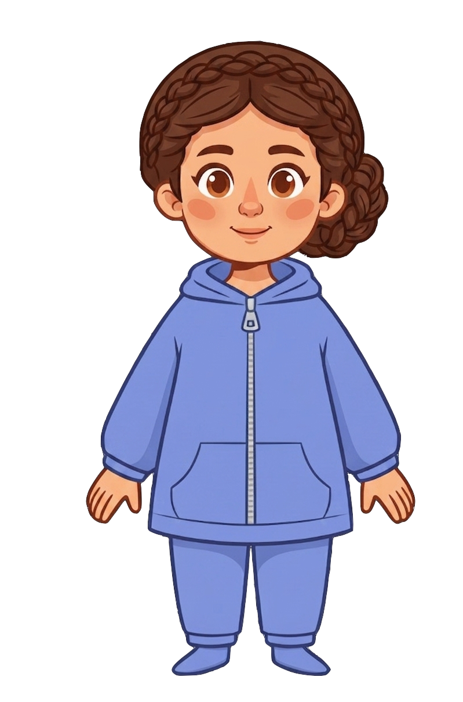
This is Catherine

Slide 2


Catherine has 5 cookies

Slide 3
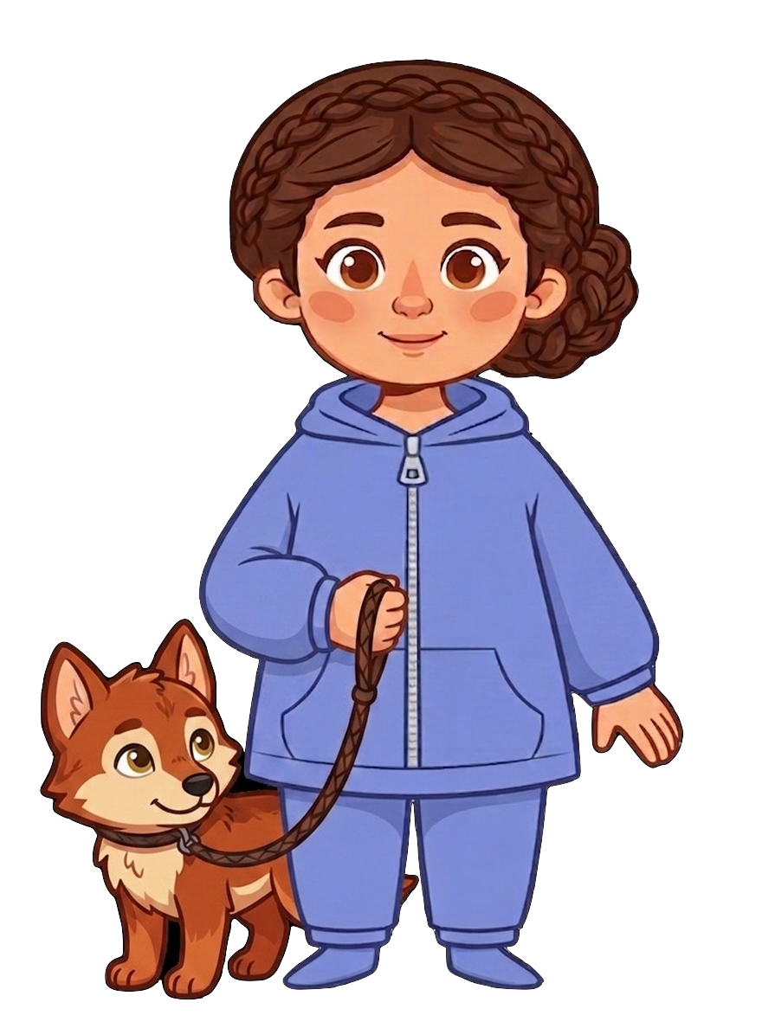
Catherine has a pet wolf

Slide 4
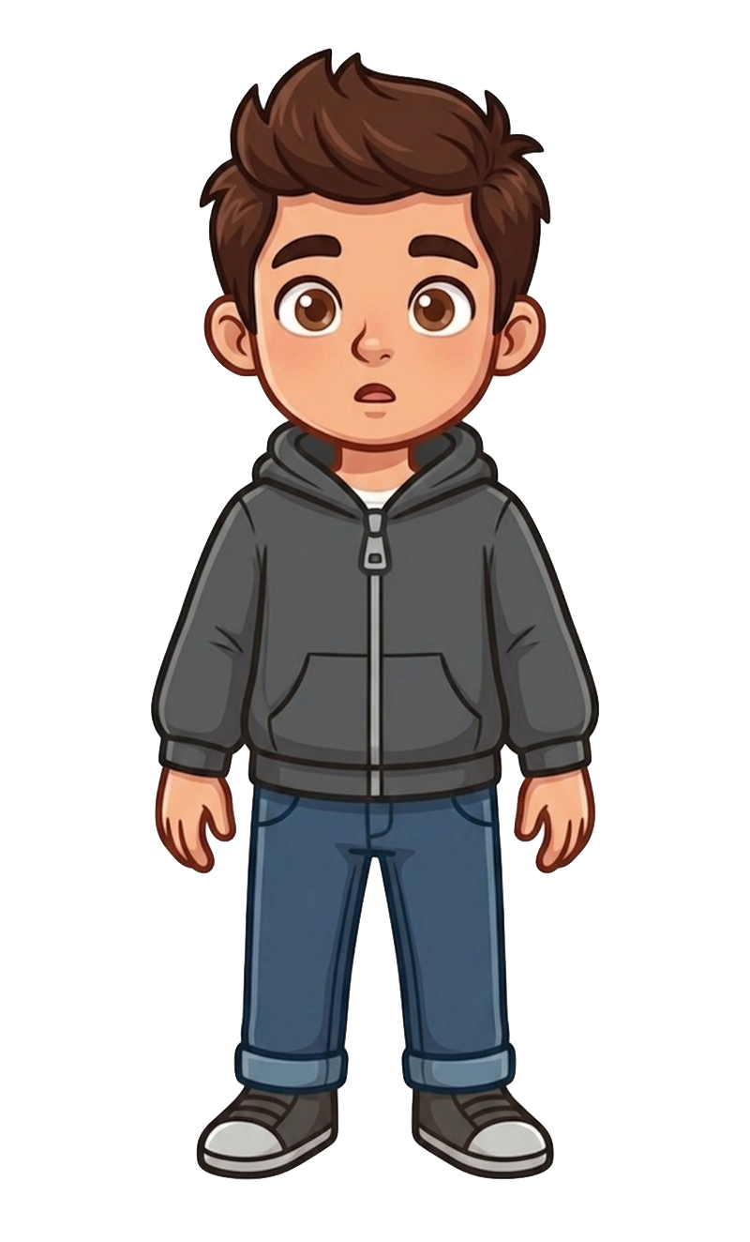
This is Andy

Slide 5
Andy has 3 cookies

Slide 6
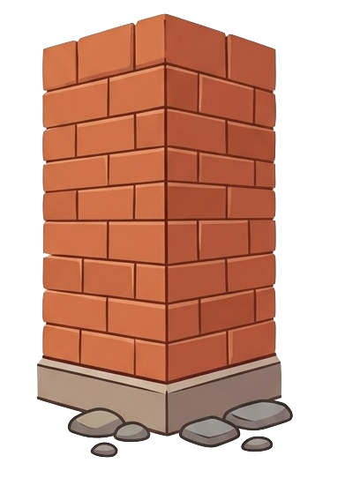
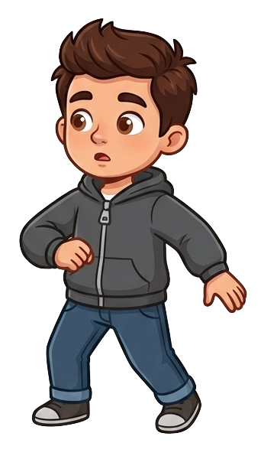
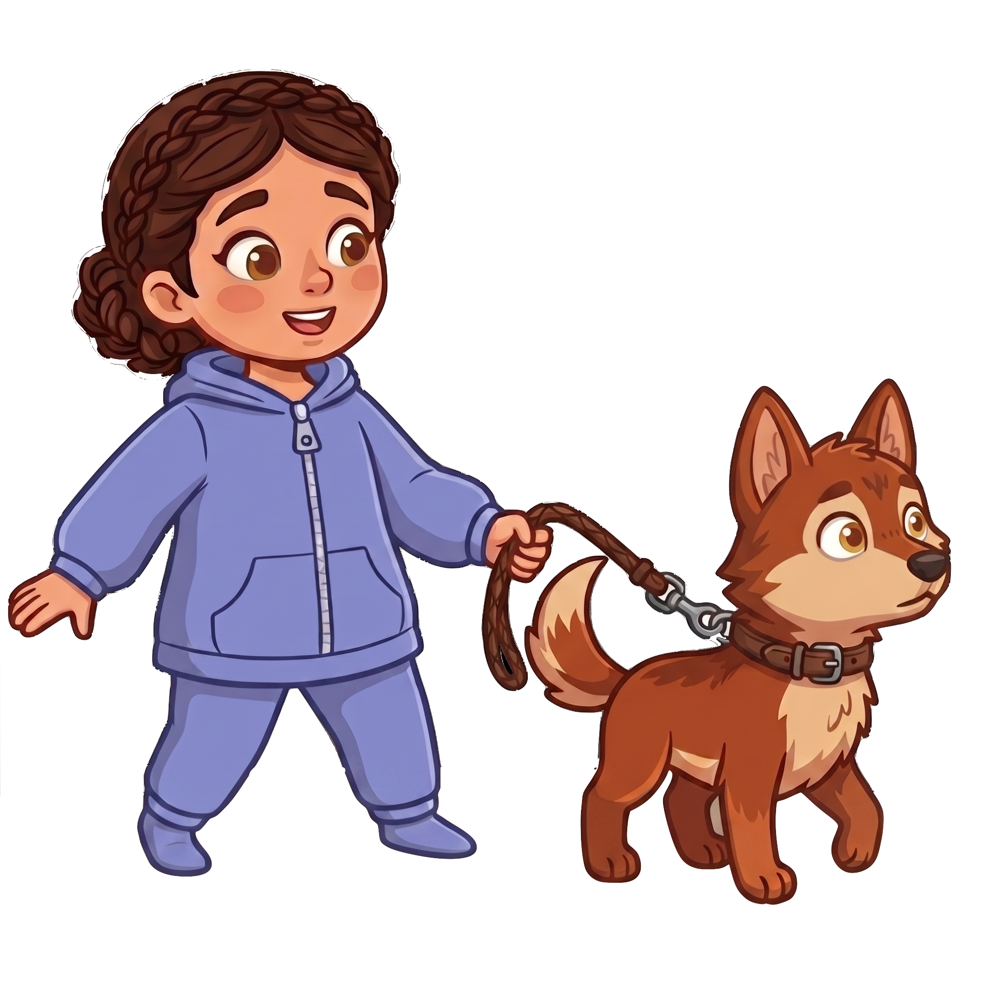
Andy and Catherine bumped into each other accidentally at the corner.

Slide 7
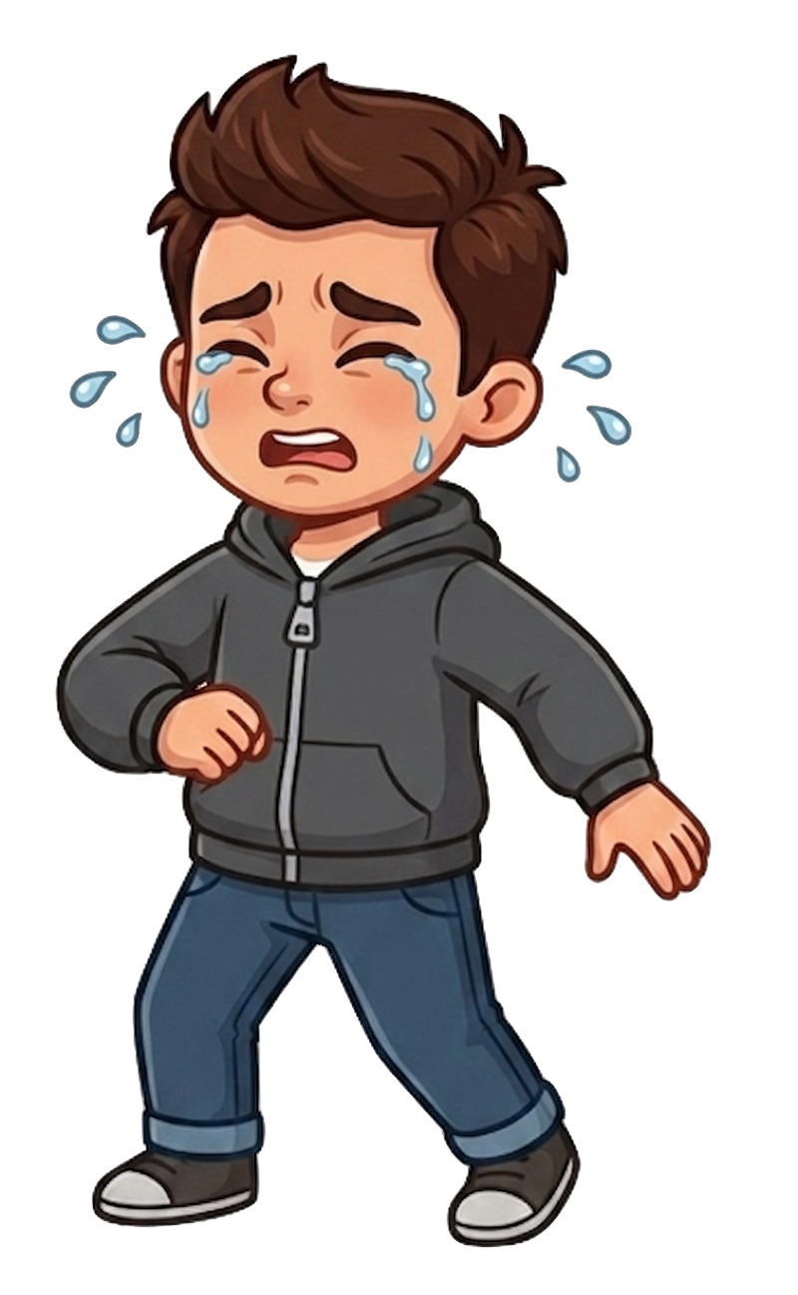
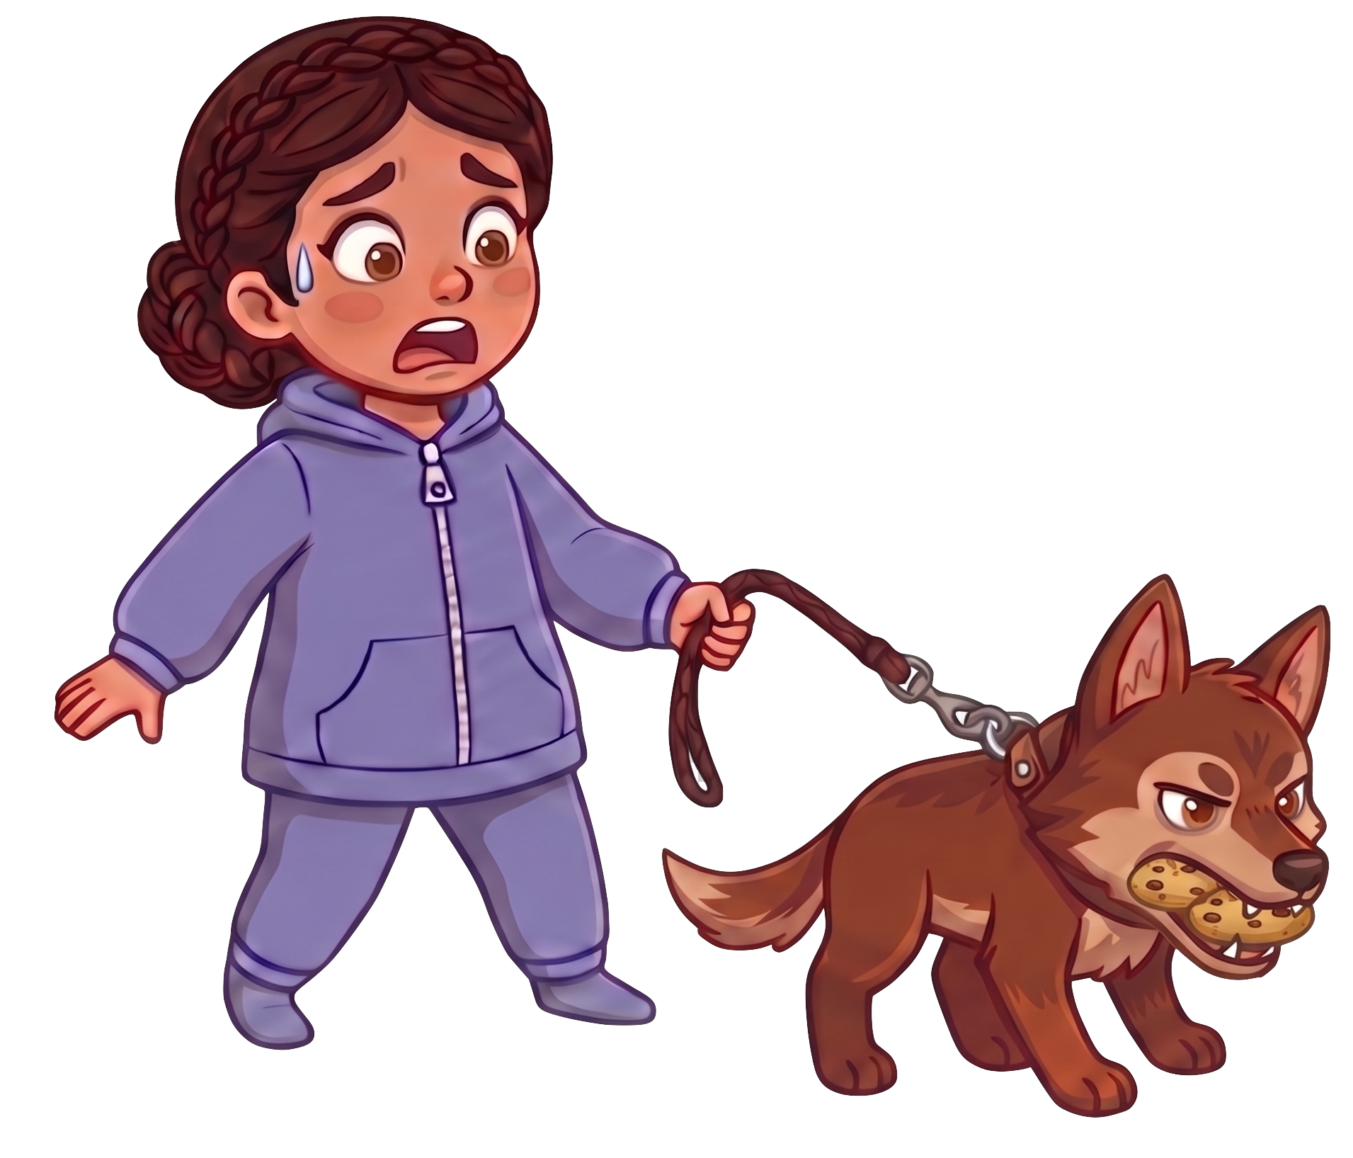
Oh no! The wolf ate 2 of Andy’s cookie!

Slide 8
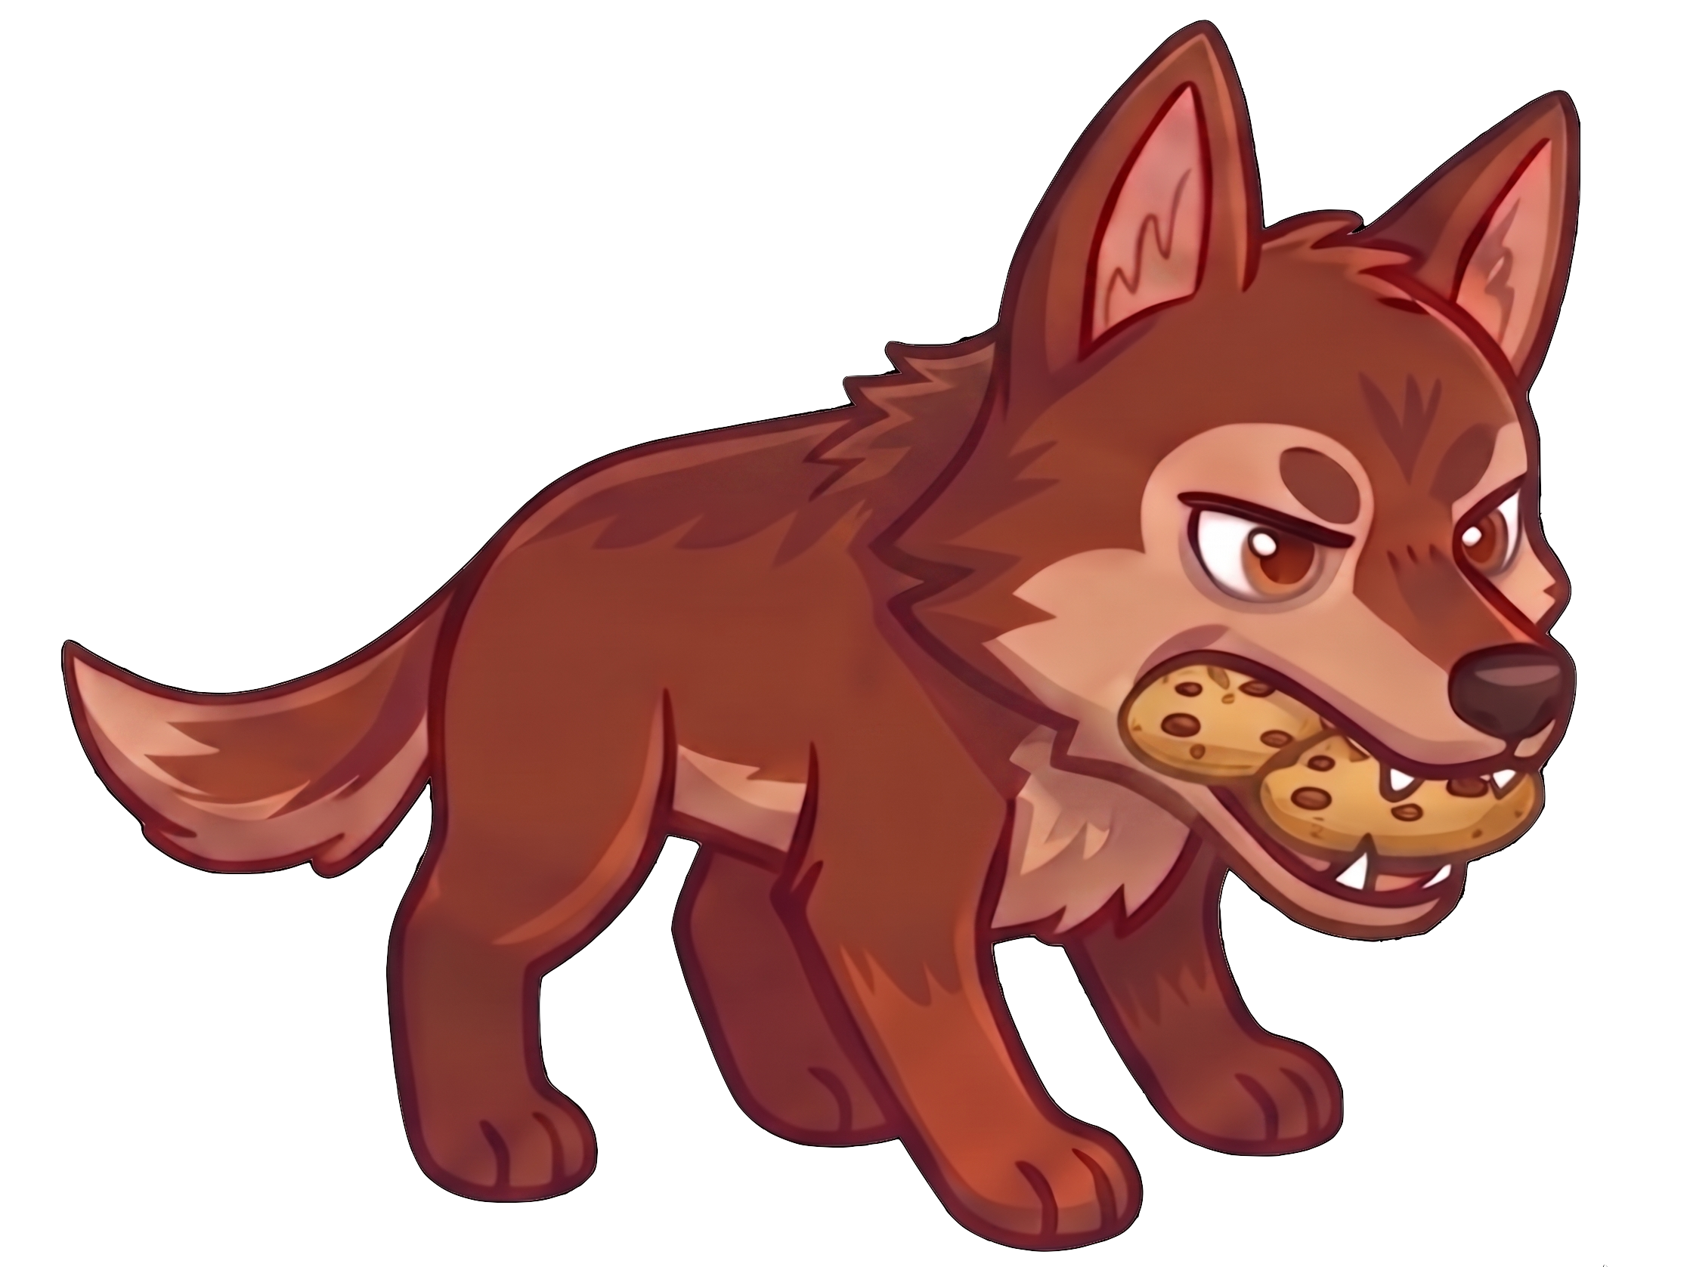
Catherine still has 5 cookies. Andy now has 2 cookies.

Slide 9
Please decide whether you would like to move some of Catherine’s cookies.

